Slide 1
DAP Lead Auditor Training
Day 4

Slide 2
Learning Objectives – Day 4
Write effective NCRs
Complete audit report
Conduct a closing meeting
  DAP Assessment and Nonconformity Procedure
  (00-OP-S0056)
Slide <number>

Slide 3
Writing NCRs
Module 11

Slide 4
Learning Objectives
Explain what causes a nonconformity
Describe key components of an NCR
Identify the main features of an NCR report form
Write an NCR successfully using the DAP Assessment Tool
Slide <number>
Notes:
Once you have confirmed the NCR, you will need to document it and issue it to the lab as part of the final report.

Slide 5
What Can Cause a Non-Conformity?
Current lab practice does not comply with requirement (internal or external).
Current implementation used to comply with requirement is not effective.
Requirements include:
  Test Standard
  Participant’s quality manual, procedure, form
  DAP requirement, client guide
Slide <number>
Notes:
Possible causes of a nonconformance:
Noncompliance to a requirement (internal or external)
Documentation or observed lab practice does not meet the requirement
The client lab has not effectively implemented a process to comply with a requirement
NOTE: Refer class to the “real-life findings” discussed at the end of each ISO/IEC 17025 clause. Discuss examples of what you have observed during your DAP audits.

Slide 6
Components of an NCR
3 Key components:
      Requirement - Expectation
      Nonconformity - The problem itself, the gap
      Objective Evidence - What was reviewed that showed nonconformance to the requirement.
  The NCR needs to stand alone for all parties to understand consistently.
Slide <number>
Notes:
NCRs should be written in 3 parts.
If written correctly, the client should be able to fully understand the finding and further investigate it.
Remember, it helps to have discussed the NCR with the lab as soon as it was discovered.

Slide 7
Specifics about Requirement
Sets the expectation
Use actual phrases from the applicable standard or document
    DAP Assessment Tool automatically populates the NCR report form using exact wording from ISO/IEC 17025.
Reference number and clause
    ISO/IEC 17025 clause
    DAP client guide number
    Standard number, edition, and clause
    Client’s procedure or form number and revision level
Slide <number>
Notes:
Auditors need to make sure they reference the correct requirement.
Exact wording from the standard or document will lower the possibility of misinterpretation and client challenges.
We always need to be able to trace the NCR back to a requirement. If an auditor cannot do this, they need to revisit whether or not they really have an NCR or not.
It is also important to reference procedure and standard numbers and clause numbers. You want to point the client and other UL staff (DAP reviewers) to the exact requirements.
Activity: Choose a “real-life finding” to write an NCR so the class has an example before they write their own.
Use flipchart to record 3 key components of the NCR (requirement, nonconformity statement, objective evidence).

Slide 8
Specifics about the Nonconformity
Describes the problem that needs to be addressed:
    What is the issue?
    What part of the requirement does it not meet?
    NO corrective action statements.
Slide <number>
Notes:
Discuss the importance of referencing the issue back to the specific requirement of the standard.
Activity: Choose a “real-life finding” to write an NCR so the class has an example before they write their own.
Use flipchart to record 3 key components of the NCR (requirement, nonconformity statement, objective evidence).

Slide 9
Specifics about Objective Evidence
Give detailed information so it can be investigated – when where, what etc.
  Example: The daily temperature log in the motor lab indicated a reading of 85 degrees on 6/10/11.
  Example: Lab records, in the motor lab, the week of June 8th, indicated environmental conditions (temp/humidity) were exceeded 4 times.
Sample size – how often
  Example: 4 out of 10 temperature records reviewed indicated the maximum temperature reading had been exceeded – with no action taken.
Slide <number>
Notes:
Activity: Choose a “real-life finding” to write an NCR so the class has an example before they write their own.
Use flipchart to record 3 key components of the NCR (requirement, nonconformity statement, objective evidence).

Slide 10
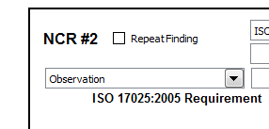
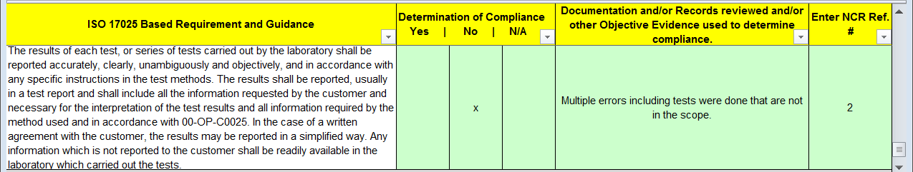
Use DAP Assessment Tool (00-OP-F0031) to write NCRs
Nonconformity Reports tab: Select NCR classification
    Corrective Action Required vs. Observation
GALO or In-house Calibration Checklist tab: Place NCR # in appropriate clause(s).
  Activity – Instructor demo ONLY to create NCR report.
Slide <number>
Notes:
Use DAP Assessment Tool to write an example NCR for the class using statements from flip-chart (previously done).
The class does not need to follow since they will do this in the upcoming activity.
Point out that to identify NCRs, they are given numbers (see “Nonconformity Reports” tab).
Need to classify the NCR as Corrective Action Required or Observation.
Some clauses repeat in the GALO and In-House Calibration Checklist. Enter the NCR# where it the clause was written against AND either:
Enter NCR in the reference column or comment column where for clauses/rows where the requirement is repeated.
Where an NCR is issued, determination of compliance is marked “No”.
Stress that consistency is very important across all reports.

Slide 11
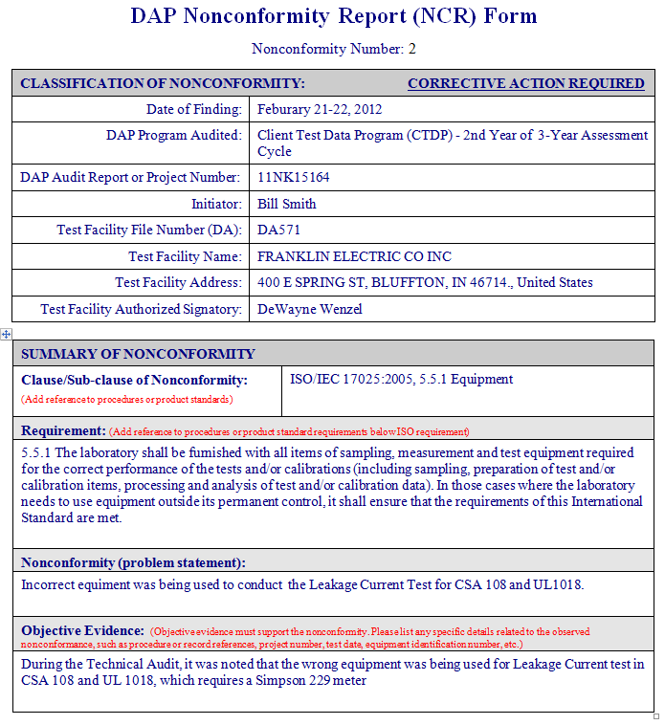
DAP Assessment Tool Creates NCR Report
Header
  Classification and NCR #
  Participant, audit info
Summary of
Nonconformity
  17025 clause/sub-clause/ standard/client guide
  Requirement
  Nonconformity
  Objective evidence
Slide <number>
Notes:
Remind class that they will have the opportunity to create their scenario based NCR but do not need laptops at this time.
Discuss the overall form and the various boxes.
Provide examples of what should be contained within each of the sections.
You might also want to give a non-example and ask the class if that should be entered or not. In this way, the class can begin to apply what they are learning.

Slide 12
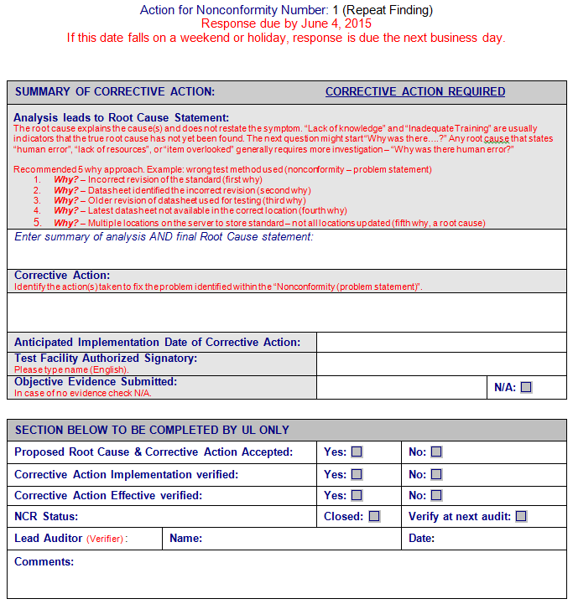
Features of the NCR Report (continued)
Summary of Corrective Action
  Root cause and analysis summary
  Short & Long term elimination
  Other data
Section completed by UL
Slide <number>
Notes:
Briefly discuss.
Explain that actual examples and evaluation of CARs will be discussed later.

Slide 13
Keys to Writing a Successful NCR
Clear concise statements
        Sufficient information
        Should be actionable
        Details of the issue
        Specific evidence
        Sample size
Tie the nonconformity and objective evidence back to the requirement
Slide <number>
Notes:
Give enough information for client and UL staff to be able to clearly identify and investigate the issue.
Many times, people outside of the audit need to review and investigate NCRs.
Auditors need to keep in mind NCRs must be concise (we should not be writing novels!, especially since we have already communicated the NCRs to the client).

Slide 14
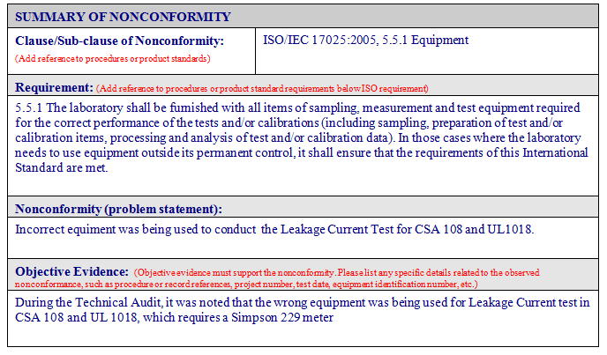
Example NCR – Effectively Written?
Slide <number>
Notes:
ASK: Do you think the nonconformity and objective evidence statements in the examples NCR are appropriate? Would you add or remove anything? (Get the class discussing to gauge understanding)

Slide 15

Module 11 – Activity 1, Writing an Effective NCR
Directions:
  Use the scenario you had for the role play.
  Instructor demo using flipchart example to write an NCR in DAP Tool “Nonconformity Report” page.
  Write an NCR and email to Instructor. Be sure to:
      Review characteristics of good statements.
      Nonconformity statement is defined well.
      Objective evidence is clear.
      It is actionable.
      Complete all sections.
  Instructor will review at least one NCR for each scenario. Class will offer feedback for everyone’s learning.
Time: Write NCR – 15 minutes
  Review NCRs – 45 minutes
Slide <number>
Notes:
This activity focuses on gaining practice in writing the NCR based on your observations and discussion with lab personnel.
If discussions resulted in no further action, distribute a new scenario to them so they can write the NCR.
ACTIVITY: Walk through creation of an NCReport using the “Nonconformity Report” tab in DAP Assessment tool.
The class has 15 minutes to write their NCR and email it electronically to the instructor so it can be discussed in class.
Answer Key: There is none. Focus the class on:
Choosing the most appropriate clause for their NCR, writing clear and concise nonconformity and objective evidence statements.
Having enough information to make it actionable but not too wordy. Otherwise, it will get confusing for the client.

Slide 16
Repeat Finding
  Repeat Finding -
  Finding identified in previous audit for which corrective action has not been completed as planned.
Finding is substantially similar in nature to one in previous audit.
Lead Auditor informs DAP Audit Manager who will review & determine the appropriate action(s).
    NA - Linda Ziemnick AP/EULA - Larisa Aoyagi
What is required of the DAP Participant? Will be informed of required actions.
  (00-OP-S0056)
  ASK: When does the Lead Auditor review last year’s NCRs?
Slide <number>
Notes:
Review definition and steps Lead Auditor takes.

Slide 17

Module Summary
Explain what causes a nonconformity
Describe key components of an NCR
Identify the main features of an NCR report form
Write an NCR successfully using the DAP Assessment Tool
Slide <number>

Slide 18

Questions?
Slide <number>

Slide 19
How to Write a DAP
Audit Report
Module 12

Slide 20
Learning Objectives
List the components that make up a DAP Audit Report
Generate a DAP Audit Report using the DAP Assessment Tool
Slide <number>

Slide 21
DAP Audit Report – Key Components
Cover Page
Assessment Summary
Findings/Nonconformities (Corrective Actions vs Observation)
Authorized Signatories
Meeting Attendance
Appendix A (NCR Response Process and Inactivation Process)
Post Audit Scope
Slide <number>
Notes:
Activity: Walk through the sample audit report identifying:
Cover Page – Project number, DA file, Client Name/Address, Program, Audit Date, Audit Team Members
Assessment Summary – Summary of the audit and recommendation to continue or suspend participation. We will discuss the key components of the summary on the next slide.
Findings – Identification of NCRs that require CAR vs Observation, association with ISO/IEC17025 Clause , Summary, Review of past NCRs for effective implementation
Authorized Signatories and Meeting Attendance - self explanatory
Appendix A - Defines the timeline and process for responding to NCRs, defines the process when “Inactivation” is recommended by the Audit Team (Inactivations will be covered later).
Post Audit Scope – The list of tests the audit team recommends for participation after the audit is completed.

Slide 22
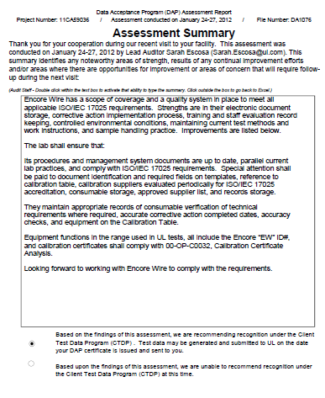
DAP Audit Report – Assessment Summary
Be sure to include:
    Areas of Strength
    Results of any Continuous Improvements
    Opportunities for Improvement
    Areas of Concern
    Select Participation Recommendation
    Important details for THIS audit
Slide <number>
Notes:
Review sample audit report for some examples of the following:
Areas of Strength
Continuous Improvements
Opportunities for Improvements - summarize NCRs issued and other suggestions.
Potential Areas of concerns
A quick snapshot of how the audit went
Be sure to identify the audit team’s recommendation to continue or suspend participation.

Slide 23
Module 12 – Activity 1, Writing an Assessment Summary & Creating the Assessment Report
Directions:
Review the guidelines for effective writing from the Writing NCRs module.
Write the Assessment Summary portion using the case scenario you have been working with.
If you need to, revise your NCR statements.
Discuss your assessment summary with the instructor who will review and provide you feedback.
Generate the DAP Assessment Report to practice using the DAP Assessment Tool
Time:
30 minutes - Individual with one-on-one Instructor feedback
10 minutes - Class Discussion
Slide <number>
Notes:
Indicate that this activity focuses on summarizing how this particular audit went.
Instructor Answer Key:
Since this is an individual activity, there are no specific answers.
Review individual’s summaries one-on-one as they complete them.
Facilitate a discussion of key points when writing the audit report (refer to last slide if needed). Provide any general feedback from your own experience on writing these reports.
Ask the class in general:
What part of writing the summary was the easiest? What was the most difficult?

Slide 24
Module Summary
Main components of a DAP Audit Report
Creating the DAP Audit Report using the DAP Assessment Tool
Slide <number>

Slide 25

Questions?

Slide 26
Conducting a Closing Meeting
Module 13

Slide 27
Learning Objectives
Describe the reasons for a closing meeting
Identify key personnel who should attend and how you document attendance
Describe the required topics covered at a closing meeting
Closing meeting preparation
Explain the appeals process
Conduct a closing meeting
Slide <number>

Slide 28
Reason for a Closing Meeting
Provides a forum to present findings, conclusions and audit team recommendation.
Opportunity to discuss and gain agreement, if appropriate.
Sets expectations for all involved
    Timeline for responding to NCRs
    Create plan to closing audit project by anniversary date (AVD)
Slide <number>
Notes:
Give some real life examples of events that have taken place in closing meetings.
Note why it is important to limit the discussion to a specific timeframe if there are diverging opinions, agree to disagree, indicate the client may appeal a finding/NCR, and move on.
Closing meetings should typically be no longer than 30 minutes.

Slide 29

Who Should Attend the Closing Meeting?
Laboratory Management
The Signatory(ies)
Auditees
“Who will be responding to the NCRs?”
Circulate a sign-in sheet, if needed
Note attendance in the Assessment Report
Slide <number>
Notes:
Discuss that DAP Auditors can not force the client to have certain attendees, they can only suggest participants.
It is up to the client to decide who will be attending the meeting.
In a rare case, a client may not wish to have a closing meeting.
If applicable, note this in your report and that you discussed NCRs as they came up and provided the client with a copy of the report and NCRs.

Slide 30
Closing Meeting Topics
Thank personnel for allowing UL to perform audit.
Restate audit purpose.
Present NCRs and audit team recommendation.
    Explain that audit report, NCRs & responses must be evaluated by UL DAP reviewers to agree with audit team.
Explain how to respond to any NCRs.
    Send response to Lead Auditor within 20 business days.
    To consider the lab’s entire management system when conducting the investigation as the audit was only a sampling.
    Appropriate Root Cause Analysis (will learn in a later module)
Slide <number>
Notes:
Understand that by UL conducting the audit, it took away from the client lab’s normal work. Thank them for allowing us to audit.
Repeat the audit purpose to show how the lab meets DAP requirements and work as partners for continuous lab improvement.
Explain to the client that the audit team can only make a recommendation to continue participation. Audit report, NCRs, and CARs must be evaluated by UL DAP Reviewers to agree with the audit team’s recommendation.
Explain how to fill out the NCR form for required CARs. And to think of the lab’s entire system, not just a quick fix to the particular issue recorded. The DAP audit is only a sampling of their system.
If lab staff begin an internal corrective action discussion and it is taking away from your agenda, politely indicate that you welcome the discussion after the closing meeting and you are available as a resource after.
Closing meetings should be 15 minutes, 30 max.

Slide 31
Closing Meeting Topics (continued)
  Set Target Dates for client and audit team if there are any unusual circumstances such as AVD expiring soon (i.e. may need the client to respond to NCRs faster
  Describe the appeals process, if needed.
If Inactivation is recommended, discuss process, timing, and outcomes.
Give client electronic copy of DAP assessment report with post audit scope & NCRs.
(00-OP-S0056 – Closing Meeting)
Slide <number>
Notes:
Be sure to set target dates for the client and the audit team (i.e. evaluate CARs, submit project to final review) to make sure the audit project is completed by the AVD.
If the client challenges an NCR, describe the appeals process they may opt to take. We will cover the appeals process later.
If Inactivation is recommended, discuss the process with the client even though instructions are defined in Appendix A of the assessment report. Let’s work with the client to all have the same understanding. We will cover Inactivations later.
Give the client an electronic copy of the assessment report, post audit scope and NCRs at the closing meeting.
As a rare exception (i.e. audit running late and need to catch a flight), you must at least provide the client with the NCRs at the closing meeting.
If you have not completed your report, you are required to send it within 5 business days. Be sure to let the client know YOUR target date for sending it to them.

Slide 32
Closing Meeting Preparation
Be sure to communicate NCRs as they arise
    Avoid “surprising” the client at closing meeting.
Regularly check with Technical Auditor(s) if they have any NCRs.
    Discuss and agree on NCRs to present a united front.
Confirm participation recommendation with all audit team members before communicating to client
Lead Auditor should plan to provide enough time to prepare the assessment report and NCR report for the closing meeting.
Slide <number>
Notes:
Add personal stories and lessons learned from your experience.
If for some reason, you cannot complete the post audit reports for the closing meeting, the requirement is to send the reports to the client within 5 business days of audit completion.
Still be sure to communicate the critical items at the closing meeting, as discussed in the previous slide.

Slide 33
Presenting the NCRs
Explain the 3 Key Components:
        What you found (objective evidence)
        What the requirement is (expectation)
        Why it is an NCR (nonconformity statement)
Use terms from DAP requirements, standards, client procedures
Provide enough information so client understands
Be concise – not wordy
Slide <number>
Notes:
Give examples of wording that would be used for each component
Explain that if the participant does not understand the NCR, they will not be able to accurately address the issue.
Be concise! If you get too wordy, the client will not understand the main issue.
Give a lengthy (bad) example of an NCR that the class does NOT want to do in the closing meeting.
Use an NTL finding
State the evidence found. Draw out using lab location, personnel you spoke with, equipment type/manufacturer/serial# etc.
Draw out the tie back to the requirement by reading the entire ISO/IEC 17025 requirement in the nonconformity statement block.
Confuse the class!
Then give a good example using your own NCR or ask student to use one of theirs.

Slide 34
Appeals Process, 00-OP-C0042
If disagreement with client continues, explain the appeals process:
Client lab sends email or letter to Regional DAP Audit Manager requesting review of a specific NCR or audit team’s recommendation for denial or suspension from DAP participation.
DAP Audit Manager acknowledges receipt within 10 business days and investigation begins.
Client is notified of the final decision within 30 business days of receipt of appeal.
Slide <number>
Notes:
Discuss the different types of appeals (denial/suspension versus NCRs).
Describe process then indicate appeals should be avoided if possible. Auditors should try to work out the issues with the client during the audit.

Slide 35
Meeting Dynamics
Things that may occur at the closing meeting:
Push back from client
Disagreements
Concerns with the total number of NCRs
Others?
Slide <number>
Notes:
Allow for some discussion to show the client respect and an open mind, but have a time limit.
If the client becomes argumentative, talk about different approaches to diffuse the problem (agree to disagree – appeals process).
The audit team MUST show agreement on NCRs. Discussions regarding NCRs between team members must take place prior to the closing meeting. If there is a need to discuss further because of additional information presented, it should be done without the client present (ask for permission). The Lead Auditor must take the lead in such instances.

Slide 36
Module 13 – Activity 1, Closing Meeting
Directions:
In your team, decide who will be Lead Auditor.
Select others to play Technical Auditors.
Prepare for the closing meeting with your NCRs.
Conduct role-play with the client (another team).
Others: complete feedback using observation sheet.
Debrief as a class.
Time:
20 minutes - Prep
20 minutes - Role play (each audit team)
20 minutes - Class Debrief
Slide <number>
Notes:
This activity focuses on the closing meeting and presenting NCRs to the client.
Refer to directions in your handout and role plays.
Change roles in your team. Do not have the same Lead Auditor.
Conduct a debrief of the activity. Ask each team for responses.
Ask:
How do you think the closing meeting went? Why?
What do you think the lead auditor did well?
What do you think he/she might do differently in the future?
What did the technical auditors do well in presenting the NCRs?
How might they improve this presentation for next time?
Tell the class they did a good job.
Have each person distribute their observation sheets to their team members.
Instructor Answer Key:
Since this role play is asking subjective questions there are no right or wrong answers.
As you debrief this activity, ensure that everyone gets a chance to provide feedback.
Monitor that the feedback is constructive and not attacking any individual personally.
Stress that they need to be sure the client understands the audit was based only on a sampling of their lab. That it is the lab’s responsibility to see if/how the NCRs affect which parts of their system.

Slide 37
Module Summary
Reasons for conducting a closing meeting
Key Personnel
Documenting attendance
Meeting topics and preparation
Appeals Process
Things to be prepared for when leading a closing meeting
Slide <number>

Slide 38
Questions?

